Slide 1
PGVCL Training
Day-5

Slide 2
Flutter Training for PGVCL Department
Day 5: Asynchronous Programming

Slide 3
Overview
Topics We’ll Be Covering For Today
Theory
Future,async/await and streams in dart
Best Practice for handling
Asynchronous task.
Practical
Create a weather app that fetches data using asynchronous programming
Assignment
Add a loading spinner and handle errors in the weather app.

Slide 4
Objectives
Understand the need for asynchronous programming.
Learn about Futures, async/await, and Streams
.
Explore Dart’s approach to managing asynchronous tasks.
Discover best practices for effective and error-free asynchronous programming

Slide 5
What is Asynchronous Programming?
Definition: Asynchronous programming allows tasks to run independently, enabling applications to remain responsive.
Analogy: Like ordering at a café – place an order, wait for it to be prepared while other orders are handled in parallel.
Key Benefits:
Improved app performance.
Non-blocking UI for better user experience.
Essential for network calls, file I/O, and database operations.

Slide 6
Why Asynchronous Programming Matters
Real-world Needs:
Fetching data from APIs.
Reading/writing large files.
Performing database queries.
Handling user inputs.
Dart's Strength:
Provides first-class support for async with Futures, async/await, and Streams.

Slide 7
Futures in Dart
What is a Future?
Represents a value that will be available at some point in the future.
Can complete with:
A value.
An error.

Slide 8
Example: dart Copy code Future<String> fetchData() async {
return 'Data loaded';
}
States of a Future:
Uncompleted
Completed with a value.
Completed with an error.

Slide 9
Async and Await
What is async?
Marks a function as asynchronous.
What is await?
Pauses the execution of an async function until a Future completes.

Slide 10
Code Example: dart Copy code Future<void> printData() async {
String data = await fetchData();
print(data); // Outputs: Data loaded
}
Benefits:
Simplifies reading and writing asynchronous code.
Makes code look synchronous and easy to debug.

Slide 11
Streams in Dart
Definition: Streams handle multiple values over time.
Use Cases:
Listening to user input.
Real-time updates from servers (e.g., live chat).

Slide 12
Types of Streams:
Single-subscription: For one listener at a time.
Broadcast: For multiple listeners.

Slide 13
Code Example: dart Copy code Stream<int> numbers() async* {
for (int i = 1; i <= 5; i++) {
yield i;
}
}
dart Copy code numbers().listen((value) {
print(value); // Outputs: 1, 2, 3, 4, 5
});

Slide 14
Best Practices for Asynchronous Tasks
Avoid blocking the UI:
Use async methods for tasks like network calls.
Handle errors gracefully: dart Copy code try {
await fetchData();
} catch (e) {
print('Error: $e');
}

Slide 15
Cancel unnecessary tasks:
Use StreamSubscription.cancel() for Streams.
Use Future.wait for parallel tasks: dart Copy code var results = await Future.wait([task1(), task2()]);

Slide 16
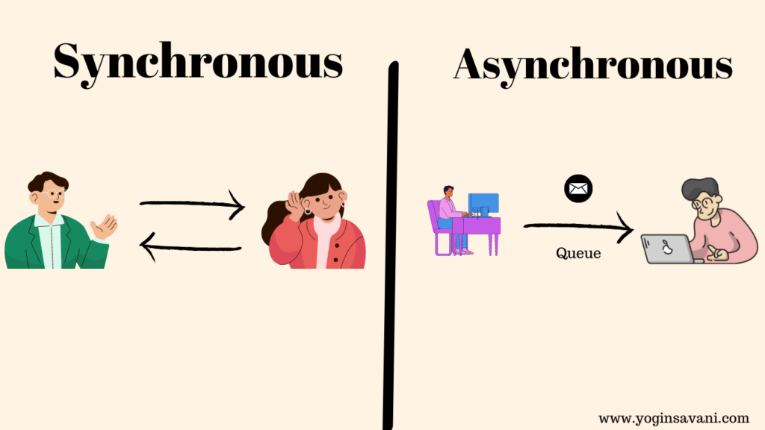

Slide 17
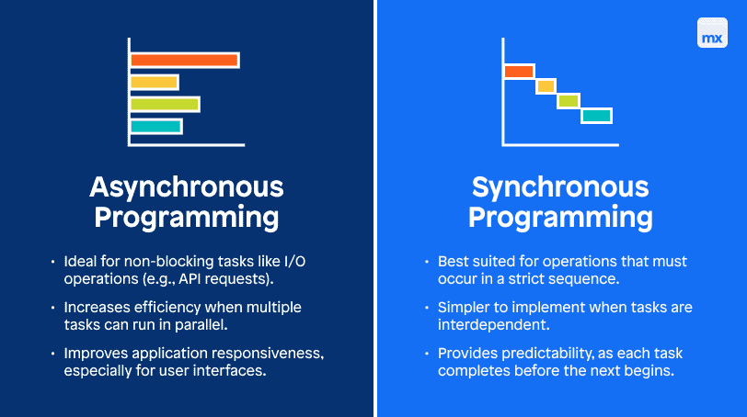

Slide 18
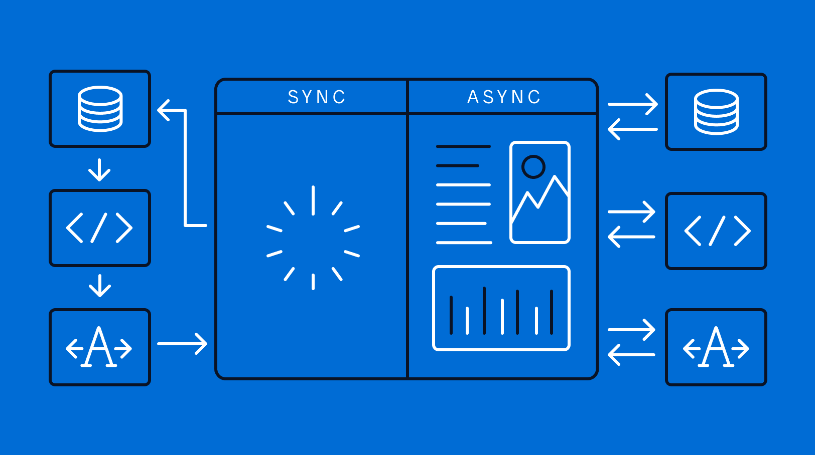

Slide 19
Final Conculsion
So Synchronous is best when you have a Small applications or scripts where operations are lightweight and fast.
Asynchronous is best when you have aApplications with multiple I/O operations, like web apps, mobile apps, or server-side applications that need to stay responsive while handling multiple tasks (e.g., network requests, database calls).

Slide 20
Practical Example
Link
Assignment Example
Create a basic UI with 3 Stateless Widgets and 2 Stateful Widgets

